Slide 1
Modelling binary outcome data
Logistic regression
Kamarul Imran Musa
Assoc Prof (Epidemiology and Biostatistics)

Slide 2
Objectives of lecture
At the end of the lecture, students will be
Able to model categorical binary outcome variable using multiple logistic regression
Able to perform model assessment
Able to interpret model

Slide 3
Introduction
We analyze data
To explain relationship between variables
To estimate the effect of a set of variables (predictors) onto another variable (the outcome)
To make inference – how large the effect?
To predict the outcome based on new data

Slide 4
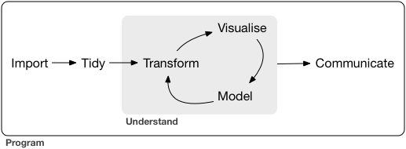
Workflow for data science
https://r4ds.had.co.nz/introduction.html

Slide 5
Modelling => Estimation and Inference
To estimate =
A process by which one makes inferences about a population, based on information obtained from a sample.
Making inference =
the reasoning involved in drawing a conclusion or making a logical judgment
on the basis of circumstantial evidence and prior conclusions
Not only on the basis of direct observation

Slide 6
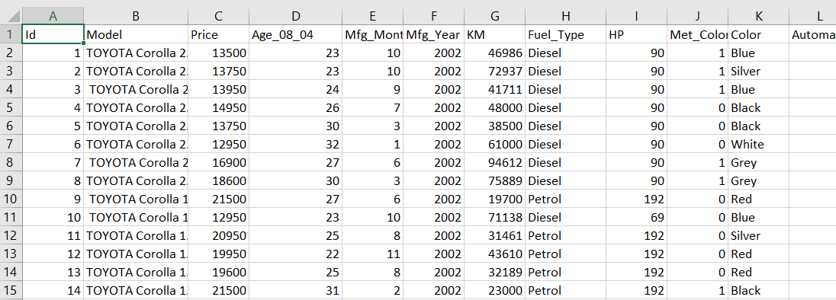
Data
Variables
Numerical
Integer
Double
Categorical
Character
Factor
Row => Observations
Columns => Variables

Slide 7
Motivation
When outcome is binary, the common analysis for making inference or prediction is logistic regression
Inference = explanation
What is the aim?
To explain vs to predict
In statistics, to explain is more common
Interested in the beta
In analytics, to predict is more common
Not interested in beta, but interested to predict the outcome

Slide 8
Questions
Give example of outcome relevant to your area that you may study
State the objective of the analysis
Are the data suitable for logistic regression analysis?

Slide 9
Outcome variable
When the outcome is categorical (in the form of binary), we model using logistic regression
Binary outcome
Acceptance of loan = Accepted vs Rejected
Loan defaulters = Yes vs No
For example :
Acceptance of loan <- gender + age + job status + ….
Loan defaulters <- age + income + amount of loan + …..
Y ∈ { 1 =Yes , 0 = No }

Slide 10
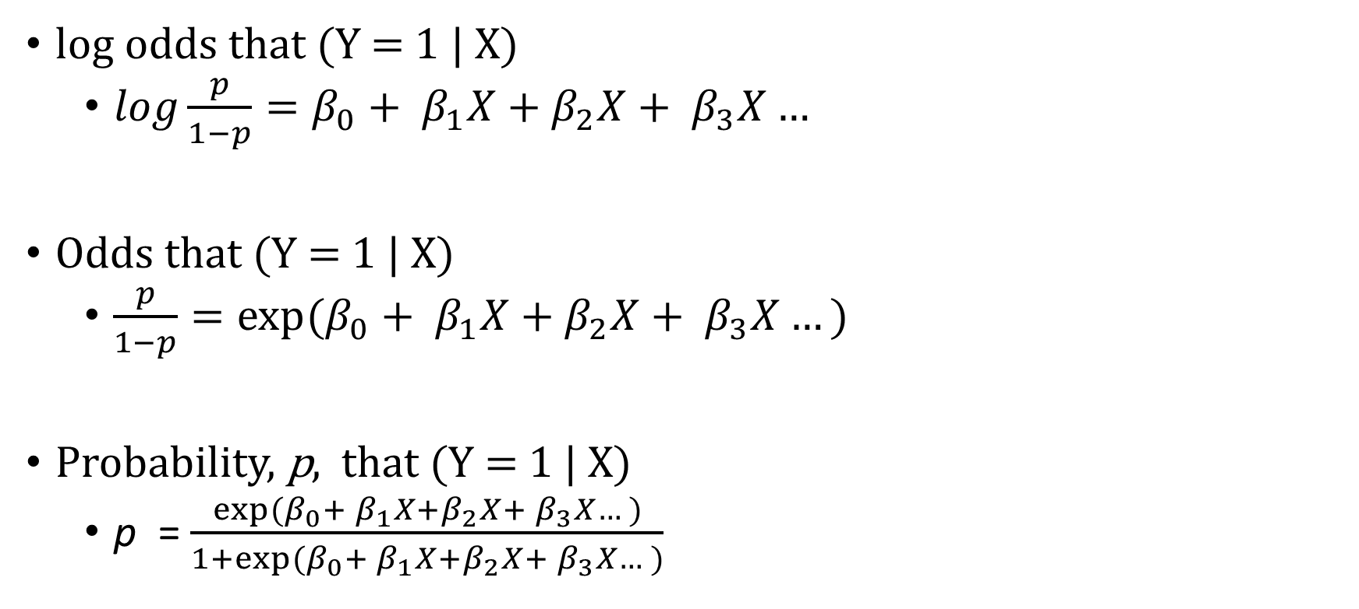
Model: Multiple Logistic Regression
log odds that (Y = 1 | X)
$log\frac{p}{1−p}=β_{0}+ β_{1}X+β_{2}X+ β_{3}X…$
Odds that (Y = 1 | X)
$\frac{p}{1−p}={exp⁡(β}_{0}+ β_{1}X+{β_{2}X+ β}_{3}X…)$
Probability, p, that (Y = 1 | X)
p = $\frac{{exp⁡(β}_{0}+ β_{1}X+{β_{2}X+ β}_{3}X…)}{1+{exp⁡(β}_{0}+ β_{1}X+{β_{2}X+ β}_{3}X…)}$

Slide 11
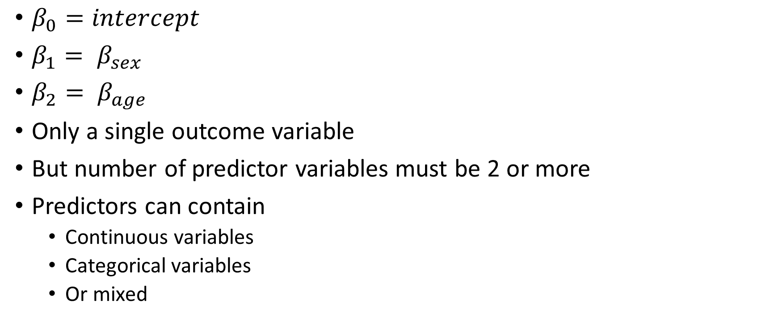
$β_{0}=intercept$
$β_{1}= β_{sex}$
$β_{2}= β_{age}$
Only a single outcome variable
But number of predictor variables must be 2 or more
Predictors can contain
Continuous variables
Categorical variables
Or mixed

Slide 12
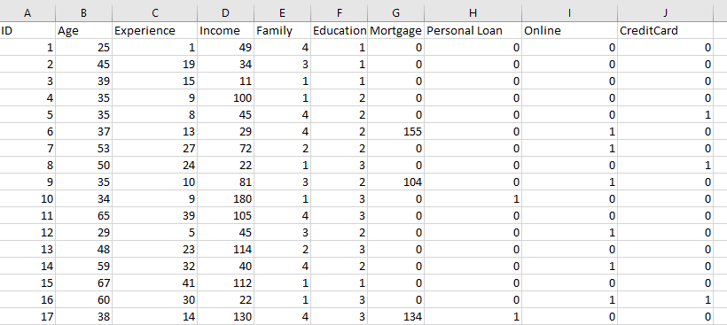
Model: Multiple Logistic Regression
2 or more predictors
Numerical?
Categorical?
Outcome?

Slide 13
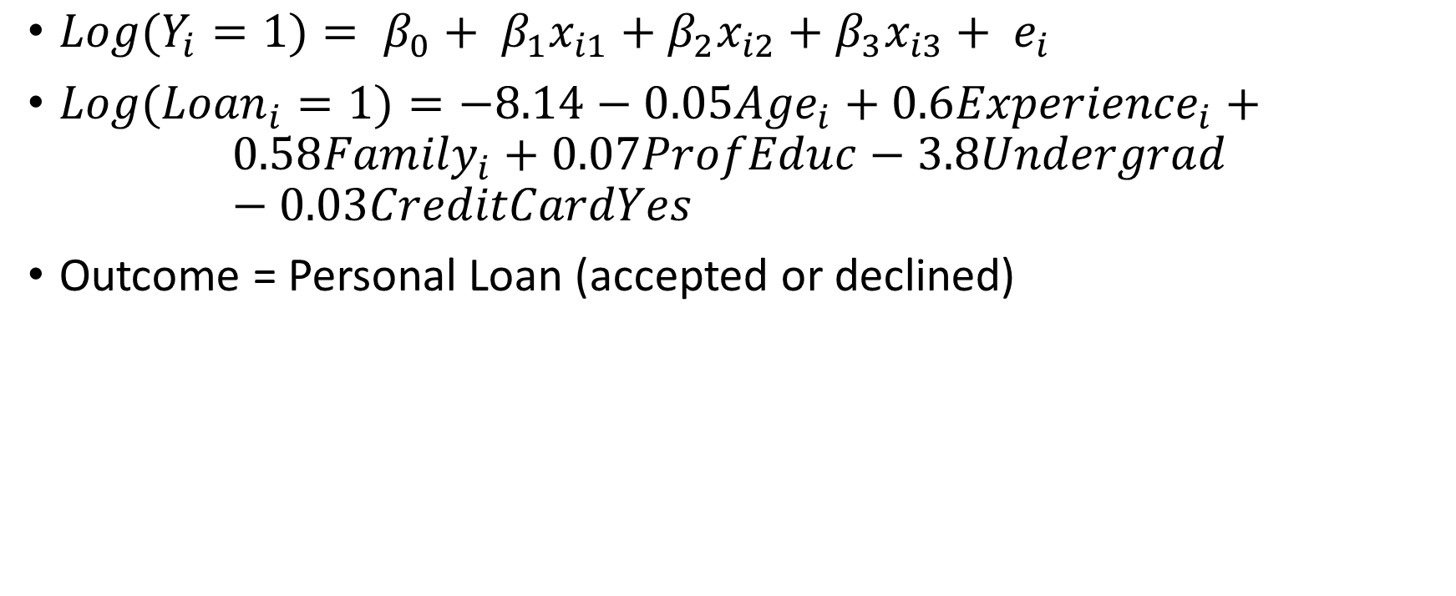
Equation: Multiple logistic Reg example
${Log(Y}_{i}=1)= β_{0}+ β_{1}x_{i1}+β_{2}x_{i2}+β_{3}x_{i3}+ e_{i}$
${Log(Loan}_{i}=1)=−8.14−0.05{Age}_{i}+0.6{Experience}_{i}+$
$$0.58{Family}_{i}+0.07ProfEduc−3.8Undergrad −0.03CreditCardYes$$
Outcome = Personal Loan (accepted or declined)

Slide 14
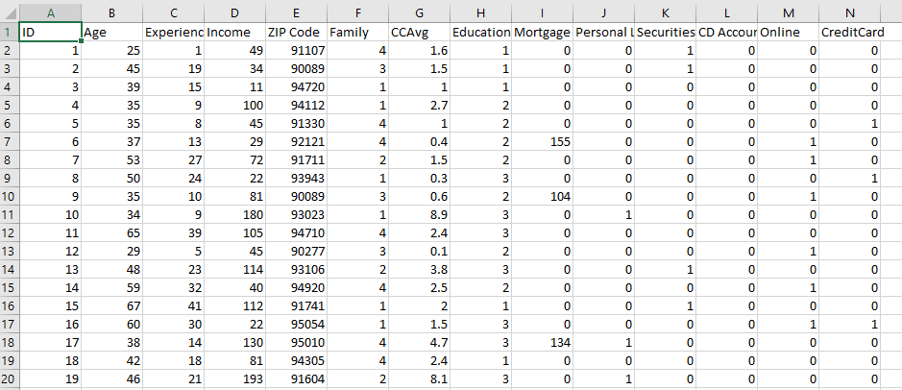
Outcome variable: Personal Loan ∈ {1 = accept loan, 0 = refuse loan}
Education ∈ {1=undergrad, 2=graduate, 3=professional}
Family size
Age
Income

Slide 15
Personal Loan
Education Status
Age
Family size
…
$$log\frac{p(Y=1)}{1−p(Y−1)}=β_{0}+ β_{1}AGE+{β_{2}FAMILY SIZE+β_{3}INCOME+}_{}$$
$$+{β_{4}GRADUATE+β_{5}PROFESSIONAL}_{}$$
$${+ β}_{6}CREDITCARDYES$$

Slide 16
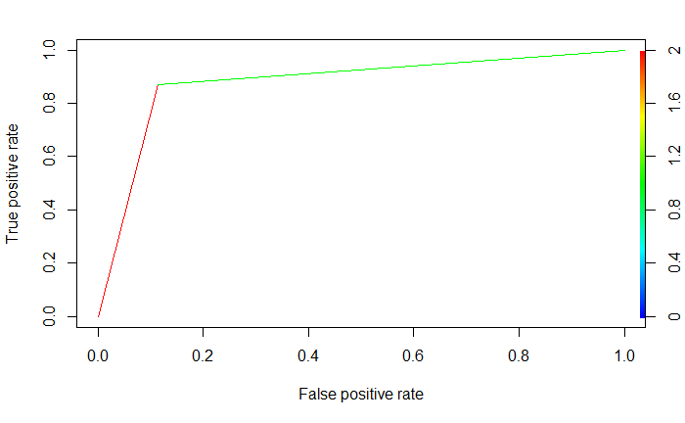
Model assessment
Area under the ROC curve
*ROC = Receiver Operating Characteristics
Confusion matrix

Slide 17
Presenting logistic regression results (log-odds)
Predictors | Log odds | std.error | statistic | p.value | conf.low | conf.high
(Intercept) | -11.94057592 | 1.67978448 | -7.10839757 | 0.0000 | -15.2219601 | -8.63233788
Age | -0.049150435 | 0.06291551 | -0.78121327 | 0.4347 | -0.17492233 | 0.07185006
Experience | 0.056461356 | 0.0625835 | 0.9021764 | 0.3670 | -0.06387962 | 0.181602
Income | 0.063365108 | 0.00258388 | 24.5232166 | 0.0000 | 0.05846667 | 0.0686049
Family | 0.583045157 | 0.07055865 | 8.26326967 | 0.0000 | 0.4464047 | 0.72323063
Educ2grad | 3.799974008 | 0.2454027 | 15.484646 | 0.0000 | 3.32971058 | 4.29249728
Educ3professional | 3.867107776 | 0.24222584 | 15.9648853 | 0.0000 | 3.4033906 | 4.35373713
CreditCard1 | -0.002646147 | 0.15844159 | -0.01670109 | 0.9867 | -0.31607895 | 0.30561917

Slide 18
Interpret results
CI = confidence intervals
When age increases for 1 year, the log odds to accept the loan decreases by 0.049. The 95% CIs of reduction range from -0.17 to 0.07 (p-val=0.435)
When income increases for USD1000 , the log odds to accept the loan increases by 0.063. The 95% CIs of increase range from 0.059 to 0.069 (p-val < 0.001)
The log odds for grad respondents to accept the loan was 3.80 compared to students. The 95% CI of range from 3.33 to 4.29 (p-val < 0.001)
The log odds for professional respondents to accept the loan was 3.87 compared to students. The 95% CIs range from 3.40 to 4.35 (p-val < 0.001)
The log odds for respondents with CC to accept the loan was -0.03 compared to non-CC holder. The 95% CIs range from -0.32 to 0.31 (p-val =0.987)

Slide 19
Interpreting logistic regression table (odds ratio)
Predictors | OR | std.error | statistic | p.value | lower CI | upper CI
(Intercept) | 0.00 | 1.68 | -7.11 | 0.0000 | 0.00 | 0.00
Age | 0.95 | 0.06 | -0.78 | 0.4347 | 0.84 | 1.07
Experience | 1.06 | 0.06 | 0.90 | 0.3670 | 0.94 | 1.20
Income | 1.07 | 0.00 | 24.52 | 0.0000 | 1.06 | 1.07
Family | 1.79 | 0.07 | 8.26 | 0.0000 | 1.56 | 2.06
Educ2grad | 44.70 | 0.25 | 15.48 | 0.0000 | 27.93 | 73.15
Educ3professional | 47.80 | 0.24 | 15.96 | 0.0000 | 30.07 | 77.77
CreditCard1 | 1.00 | 0.16 | -0.02 | 0.9867 | 0.73 | 1.36

Slide 20
When age increases for 1 year, the odds to accept the loan reduce by 5%. The 95% CI of change ranges from 0.84 to 1.07 (p-val=0.435)
When income increases for USD1000 , the odds to accept the loan increases by 7%. The 95% CI of increase ranges from 6% to 7% (p-val < 0.001)
The odds for grad respondents to accept the loan was 44 times higher compared to students. The 95% CI of range from 27 to 73 (p-val < 0.001)
The odds for professional respondents to accept the loan was 48 times higher compared to students. The 95% CIs range from 30 to 78 (p-val < 0.001)
The odds for respondents with CC to accept the loan was similar compared to non-CC holder. The 95% CIs range from 0.73 to 1.36 (p-val =0.987)

Slide 21
Summary
The outcome is a categorical variable with two levels (or groups)
The predictors can include numerical only, categorical only or mixed.
For categorical predictor, make sure you know which level (or group) is the reference (or baseline) level (or group)
Interpret the log odds and the odds ratio
Inference is based on confidence intervals and p-values

